Slide 1
Flash Memory for Ubiquitous Hardware Security Functions
Yinglei Wang, Wing-kei Yu, Shuo Wu, Greg Malysa,
G. Edward Suh, and Edwin C. Kan
Cornell University
May 21st, 2012

Slide 2
Outline
Motivation
Flash memory basics
Device fingerprinting
True Random number generation (RNG)
Summary

Slide 3
Hardware Security Functions
Device-specific fingerprints or secrets
Physically unclonable functions (PUF)
Authenticate hardware, bind IP/secret to a device, etc.
True random number generators (RNG)
Ensure freshness of communication
Pseudo-random numbers on a virtual machine can be predictable
Untrusted Supply Chain / Environments
Authentic
IC
???
Is this IC
authentic?
PUF
PUF
Challenges
Responses
Challenges
Responses
=?
Notes:
Bits in software can be easily copied
a recent study showed that reuse of virtual machine (VM) snapshots can break the Transport Level Security (TLS) protocol due to predictable random numbers

Slide 4
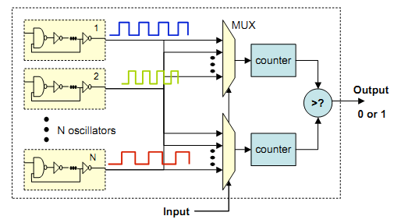
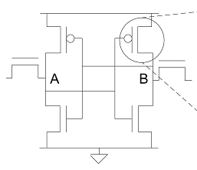
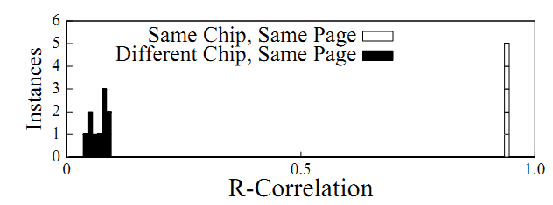
State of the Art - Device Fingerprinting
Device Fingerprinting
Need special circuits; interference with normal operation
Flash memory fingerprints, speed and applicability issues
Identical ring oscillators, Suh et al., DAC 2007
Initial state of SRAM, Holcomb et al., RFID security, 2007
Rare disturb phenomena, Prabhu et al., Trust 2011

Slide 5
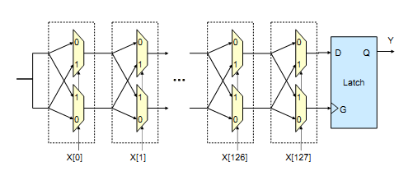
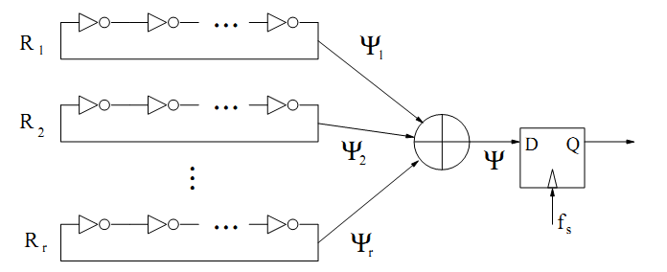
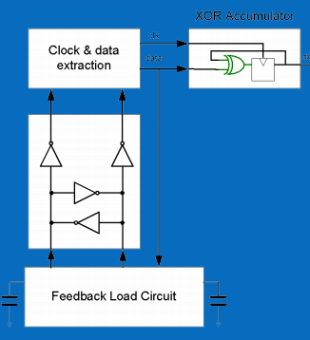
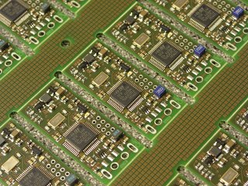
State of the Art - Hardware RNG
Hardware random number generation (RNG)
Without quantum-random properties
Low-temperature attack; Need special circuit
Delay paths, Odonnell et al., MIT, 2004
Phase noise, Sunar et al., IEEE Transactions on Computers, 2007
Avalanche noise, Entropy key product
Metastability, Cox et al., Hot Chips, 2011

Slide 6
Flash-Based Security Functions
Unmodified Flash memory for security functions
Device fingerprinting
True random number generator
Flash memory is ubiquitous
Mobile devices, SSD, USB, etc.
Pure software implementations
Works with TI MSP430F2274 Microcontroller(16-bit RISC mixed-signal, used in sensor networks)
TI OMAP4430 / NVIDIA Tegra 3 (ARM architecture) should also work (smartphones--android, galaxy, kindle fire)
Notes:
Show the msp430 device and say we can demo it (same code, device-specific output)
If you are interested, you can come to us during the breaks and we can show you how the same code can produce device specific results.

Slide 7
Outline
Motivation
Flash memory basics
Device fingerprinting
True Random number generation (RNG)
Summary

Slide 8
Flash Memory Operations
Erase
Program
Threshold Voltage
V_{th} ‘1’
Read
V_{th} ‘0’
Page 0
Page 1
Page 2
…...
Block
010011111000
011111111010
010010011001
…...
Original Data
111111111111
111111111111
111111111111
…...
After Erase
111111111111
000000000000
111111111111
…...
Program Page 1

Slide 9
Outline
Motivation
Flash memory basics
Device fingerprinting
True Random number generation (RNG)
Summary

Slide 10
Flash PUF (Fingerprints)
Process variation makes every Flash bit unique
Threshold voltage (program/erase time)
Wear-out from P/E cycles
Program/read disturb [Prabhu et al., TRUST 2011]
Quantization margins in sense amplifiers
However, digital interfaces are built to hide such analog variations
How to expose the variations?

Slide 11
Partial Programming
Standard Flash interfaces (such as ONFI – Open NAND Flash Interface) support an abort operation
Program/erase can be interrupted
Enables partial programming of individual bits
Bit 2
Partial Programs
Bit 1
Program
Threshold Voltage
V_{th} ‘1’
Read
V_{th} ‘0’

Slide 12
Fingerprinting Algorithm
Erase a block, pick a page
Partial program
Read the page and record the bits flipped in this partial program
Repeat the above two steps until most bits flipped
1 1 1 1 1 1 1 1
0
1 0 1 1 1 1 1 1
1
1 0 1 1 0 0 1 1
2
1 0 0 1 0 0 1 0
3
0 0 0 1 0 0 0 0
4
0 0 0 0 0 0 0 0
5
Final results:
4 1 3 5 2 2 4 3
Notes:
Explain number on right means how many parital programs we have done so far,
Explain final results by saying that bit 1 took 4 PP’s to flip to 0, bit 8 took 3

Slide 13
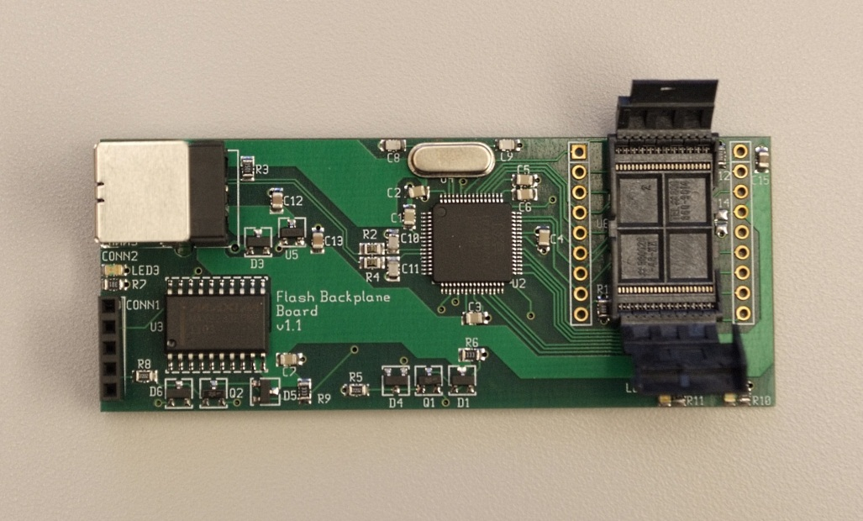
Experimental Setup
Flash test board
ARM microcontroller
Socket for commercial off-the-shelf (COTS) Flash
USB output
All components available COTS
Flash chips
Manufacturer | Capacity | Quantity | Technology
Numonyx | 4Gbit | 3 | 57nm SLC
Hynix | 4Gbit | 10 | SLC
Micron | 2Gbit | 24 | 34nm SLC
Micron | 16Gbit | 5 | MLC
Notes:
Go through this quickly

Slide 14

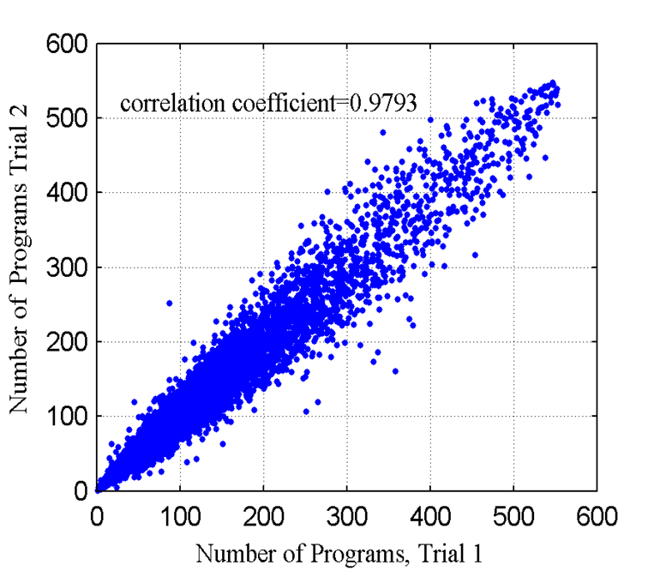
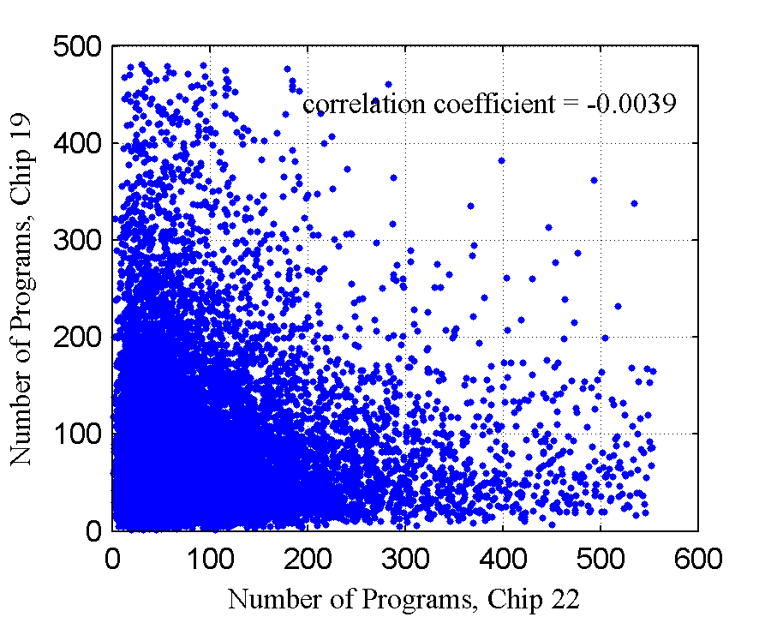
Partial Program Number Fingerprints
Correlation Function:
Same page, same chip
Same page, different chips
Notes:
Same chip, high
Different chip: low
Can effectively authenticate a chip

Slide 15
Larger Scale Experiments
24 Micron chips
24 pages from each chip
10 measurements from each page
16,384 bits per page

Slide 16
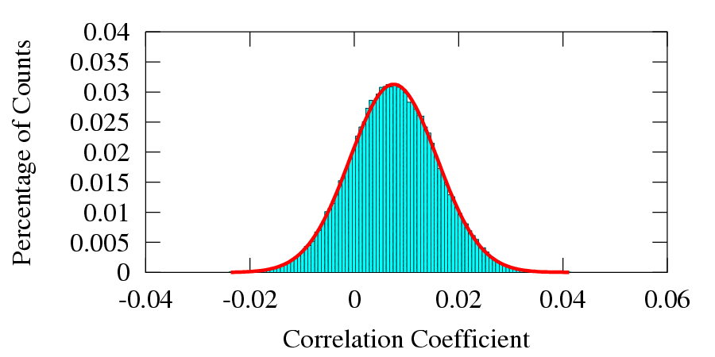
Uniqueness (Inter-Chip Variations)
Compare measurements of the same page on different chips
66,240 pairs compared
(24 chips choose 2) × 24 pages × 10 measurements
Histogram with Gaussian fit in red outline
Notes:
The transition sentence on this page: Here are the results. As we mentioned before, every chip is unique and this is shown by the inter-chip variations. When we compare two measurements on the same page from different chips, the correlation should be very low. Here is a histogram of ….

Slide 17
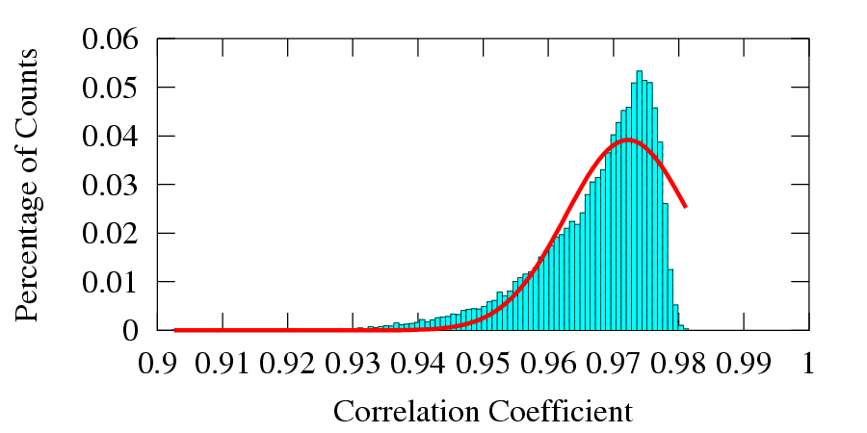
Robustness (Intra-chip variations)
Compare multiple measurements from the same page on the same chip
25,920 comparisons
Notes:
Also, the same chip should be identified as the same chip and this is shown by the intra-chip variations.

Slide 18
Performance
False negatives
Measurements from different pages show as the same page
Probability from overlapping Gaussians is 10⁻⁸¹⁵
False positives
Measurements from same page show as two different pages
Probability from overlapping Gaussians is 10⁻⁵³⁹
Time
~10 seconds for all 16,384 bits in one page
< 1 second for a 1,024-bit fingerprint
Notes:
The original version used the conservative estimation t=0.3 and t=0.7, I changed to using threshold of 0.5

Slide 19
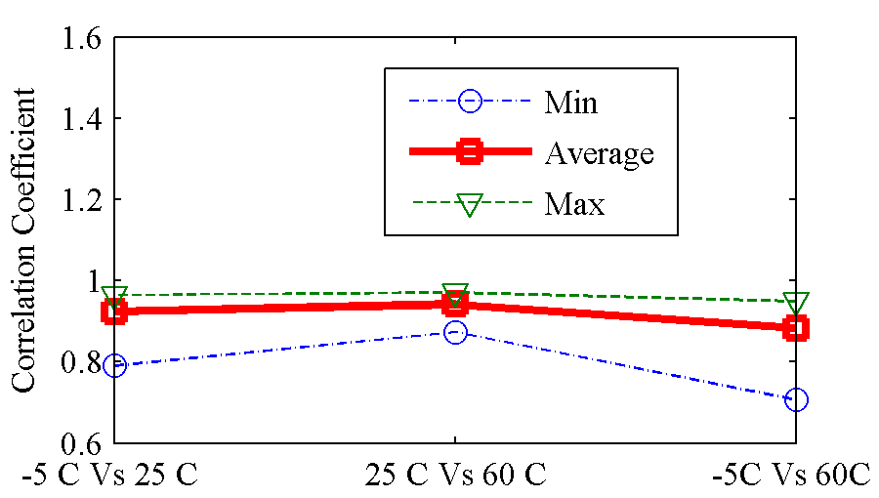
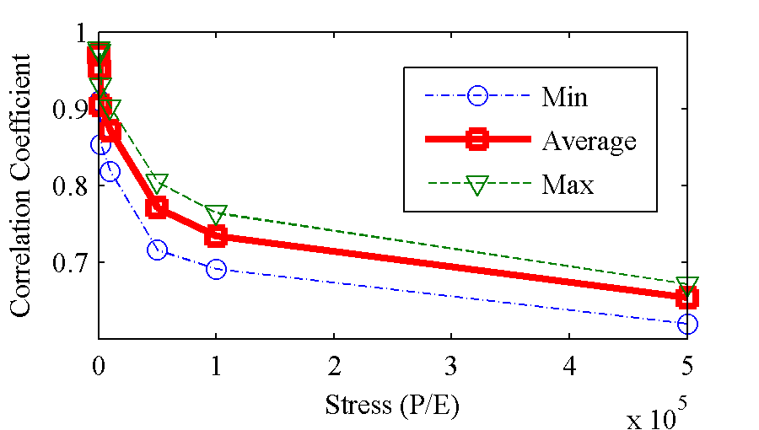
Temperature Variation and Aging
Temperature
Correlation between measurements on the same pages is lower, but high enough
Aging
Flash memory chips change with aging (program/erase stress)
Correlation is again reduced, but high enough even after 500,000 cycles
Specified flash chip lifetime
Notes:
Explain x axis of aging

Slide 20
Fingerprint Security
What does it take to fully characterize and memorize fingerprints for the entire Flash chip?
Takes about 10 bits to store ordering
10x storage
Many pages, ~10 seconds to characterize a page
16Gbit → 1 million pages → ~17 weeks
Notes:
These would make the cost of faking a chip too high for economic purposes.

Slide 21
Outline
Motivation
Flash memory basics
Device fingerprinting
True Random number generation (RNG)
Summary

Slide 22
Noises in Flash Memory
Two types of noises
Thermal noise (without quantum property)
Random telegraph noise (RTN, caused by single electron capture and emission in the device, quantum noise)
Noise extraction
Partial Programs
Single Electron Emission
Single Electron Capture
V_{th} ‘1’
V_{th} ‘0’
Threshold Voltage
Stable ‘1’
Thermal noise region
Stable ‘0’
Notes:
Link RNG to noise… our rng is based on noise in flash memory.
From the threshold voltage perspective

Slide 23
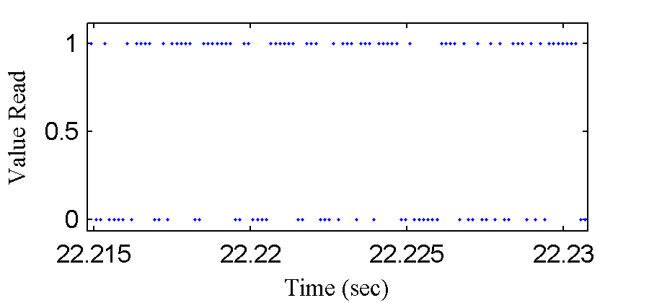
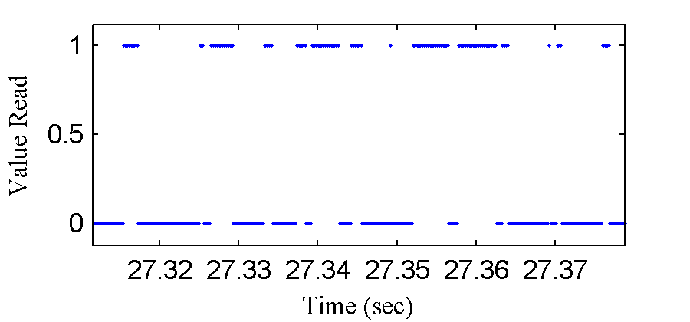
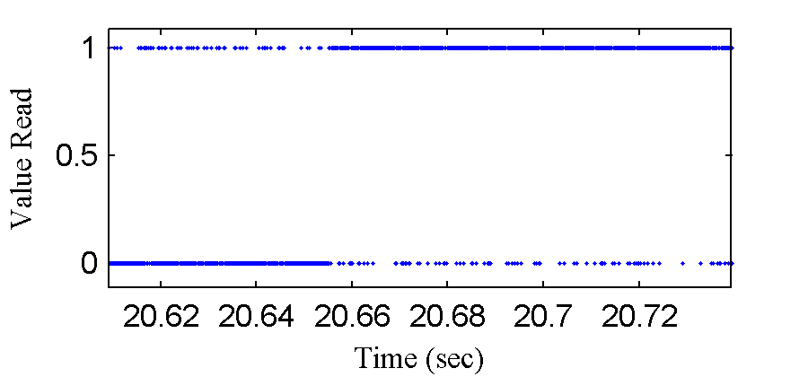
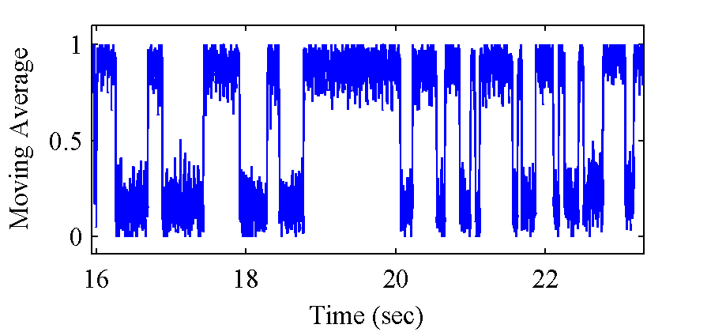
Observed Noise Types
Want RTN as quantum noise from single electron interaction
Pure thermal
RTN
RTN + Thermal Noise
Moving average from
RTN + Thermal Noise
Notes:
Either don’t show this, or go through it quickly

Slide 24
RNG Algorithm
Erase
Partial program
Read the page N times, if one oscillating bit shows RTN, record its position and partial program number
Repeat above 2 steps until all bits are programmed
Erase, partial program all RTN bits to proper level
Read these bits M times
Debiasing
1
1
1
1
1
1
1
1
0
1
1
1
1
0
1
1
1
1
1
0
1
2
1
0
1
1
1
1
1
0
0
1
1
3
1
1
1
0
1
.
.
.
1
0
0
k
0
0
0
0
0
0
1
1
1
1 1 1
Parallel
0 0 0
1
1

Slide 25
Randomness
Use NIST Statistical Test Suite 2.2.1 (Aug. 2010)
15 tests
10 sequences of 200,000 bits
Generated from flash bits with pure RTN
All pass!
10 sequences of 600,00 bits tested
Generated from flash bits with RTN components
All pass!
Notes:
To evaluate our results

Slide 26
Throughput: bits with Pure RTN
Chip | Hynix SLC | Numonyx SLC | Micron SLC | Micron MLC
Reading speed (KHz) | 46.5 | 45.3 | 43.1 | 17.8
Number of bits characterized | 303 | 478 | 1030 | 134
Number of bits identified | 9 | 16 | 5 | 0
Max throughput (Kbits/sec) | 8.03 | 5.35 | 2.71 | --
Avg. throughput (Kbits/sec) | 3.27 | 1.79 | 0.848 | --
Min throughput (bits/sec) | 107 | 34.8 | 8.14 | --
Notes:
All throughputs are for single flash bit

Slide 27
Throughput: bits with RTN component
Chip | Hynix SLC | Numonyx SLC | Micron SLC | Micron MLC
Reading speed (KHz) | 46.5 | 45.3 | 43.1 | 17.8
Number of bits characterized | 303 | 478 | 1030 | 134
Number of bits identified | 27 | 81 | 58 | 28
Max throughput (Kbits/sec) | 11.5 | 9.68 | 10.0 | 3.83
Avg. throughput (Kbits/sec) | 3.28 | 3.87 | 3.53 | 1.26
Min throughput (bits/sec) | 28.4 | 10.2 | 8.14 | 55.1
We can use all of the bits if both thermal and RTN are used!
Notes:
If we don’t care about RTN or thermal, we can use every bit

Slide 28
Environmental Variations
Tested at -5 °C and -80 °C
Thermal noise goes down with temperature
RTN exists even at low temperature
Aging
Tested at 10³ and 10⁴ P/E cycles
More noisy bits from aging
Notes:
Theoretically, the amplitude of RTN is independent of the temperature and some work shows the switching of RTN behavior even exists when the temperature approaches absolute zero

Slide 29
Outline
Motivation
Flash memory basics
Device fingerprinting
True Random number generation (RNG)
Summary

Slide 30
Summary
Flash memory is everywhere and can be used for computer security purposes without hardware changes
Flash memory device fingerprinting
Fast
Robust and unique signatures
Resistant to temperature variations and aging
Flash memory as a True RNG
Quantum noise from RTN and thermal noise
Viable across temperature ranges, aging

Slide 31
Applicability
Erase/program/read to the same physical address
Accept RESET command when the chip is busy
Disable ECC

Slide 32
NIST Test Suites
Test Name | Test Description
1 The Frequency (Monobit) Test: | Tests proportion of zeros and ones for the whole sequence.
2 Frequency Test within a Block | Tests the proportions of ones within M-bit Block.
3 The Run Test | Tests the total number of runs in the sequence, where a run is an uninterrupted sequence of identical bits
4 Tests for the Longest-Run-of-Ones in a Block | Tests the longest run of ones within M-bit Block and consistency with theory
5 The Binary Matrix Rank Test | Tests rank of disjoint sub-matrices of the entire sequence and independence
6 The Discrete Fourier Transform (Spectral) Test | Tests the peak heights in the Discrete Fourier Transform of the sequence, to detect periodic features that indicates deviation of randomness
7 The Non-overlapping Template Matching Test | Tests the number of occurrences of a pre-specified target strings
8 The Overlapping Template Matching Test | Tests the number of occurrences of a pre-specified target strings. When window found, slide only one bit before the next search
9 Maurer’s “Universal Statistics” Test | Tests the number of bits between matching patterns
10 The Linear Complexity Test | Tests the length of a linear feedback shift register, test complexity
11 The Serial Test | Tests the frequency of all possible overlapping m-bit pattern
12 The Approximate Entropy Test | Tests the frequency of all possible overlapping m-bits pattern across the entire sequence
13 The Cumulative Sums (Cusums) Test | Tests maximal excursion from the random walk defined by the cumulative sum of adjusted (-1, +1) digits in the sequence
14 The Random Excursion Test | Tests the number of cycles having exactly K visits in a cumulative sum random walk
15 The Random Excursions Variant Test | Tests the total number of times that a particular state is visited in a cumulative sum random walk

Slide 33
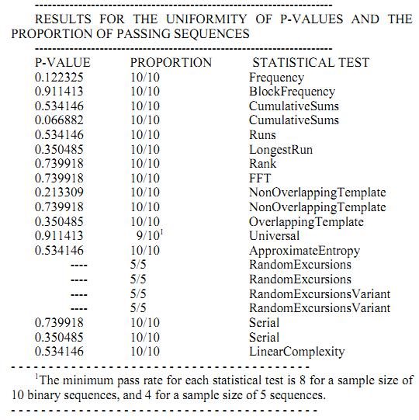
NIST Test Results
Notes:
lalalala

Slide 34
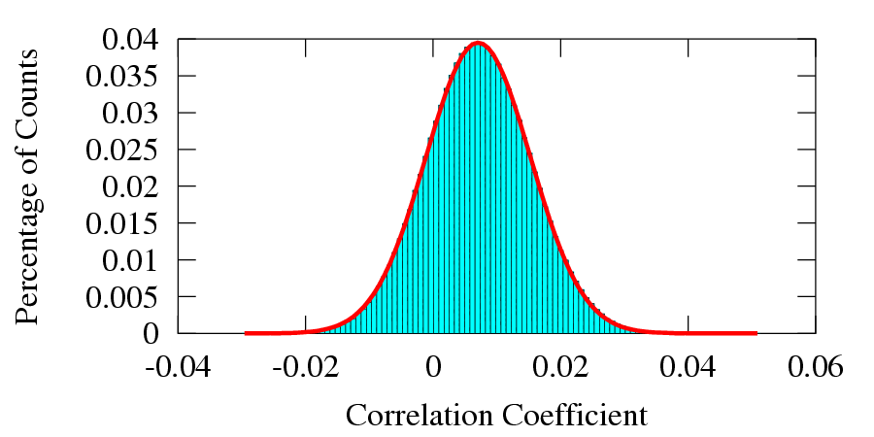
More Uniqueness: Different Pages
Compare correlation coefficients from measurements of different pages on different chips
1,656,000 pairs compared
((24 chips × 24 pages) choose 2) × 10 measurements
Notes:
Optional, perhaps not

